Slide 1
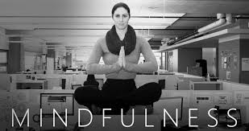
Mindfulness for Quality Improvement Presented by: Lydia Gadd

Slide 2
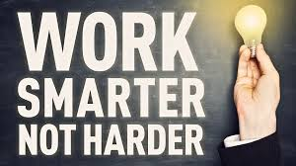
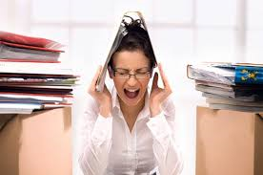
PROBLEM: Working More Hours and Producing LESS:
ANSWER: Mindfulness Training
Research Based
Brain Training
Stress Reduction
PRACTICE: Ideas to practice Mindfulness in your routine
A test of your focus: Find an example of broken focus

Slide 3
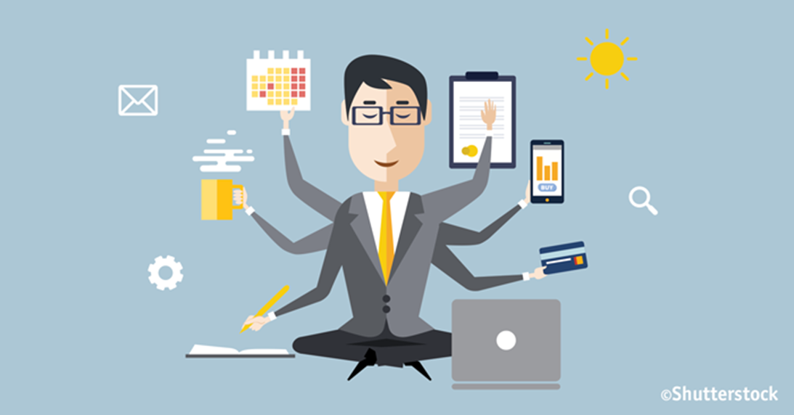
WHY ARE WE WORKING MORE AND PRODUCING LESS?

Slide 4
Distracted Workers
Continuous Partial Attention and Multi-tasking
7 Distractions per hour (average)
A 28 second distraction doubles the likelihood of errors
(Journal of Experimental Psychology, 2013)
Full Minds that Naturally Wander
Computer users at work check email, or other programs 37x/hour
By 2008 people consumed 3x more information per day than in 1960 “our minds are full”
Self-Induced distractions
Lure of technology & multitasking promotes a dopamine rush that can be addictive….anxiety when away from social media too long

Slide 5
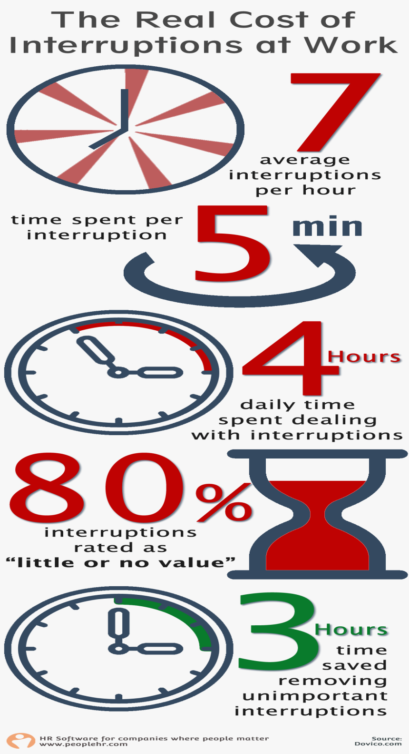
Employees are Overwhelmed by Distractions
Work stress levels at an all time high
40% of workers self report they are frequently distracted and unable to overcome
42% of workers come in early or stay late to avoid distractions and get work done
Work related stress, burnout and depression predicted to be among the world’s most prevalent diseases by 2020 (World Health Organization) - as prevalent as diabetes
Workplace Productivity Report 2013
Deloitte Study on Human Capital Trends 2014

Slide 6
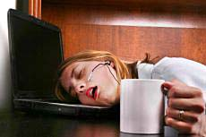
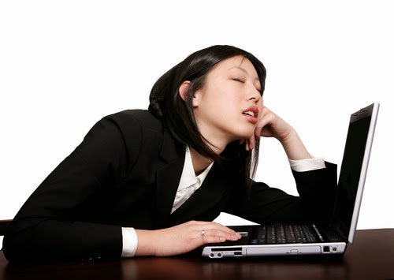
Distracted workers = Stressed workers
WHO IS MOST AFFECTED?
WHAT IS THE OUTCOME OF A STRESSED, DEPRESSED AND SLEEP DEPRIVED WORK-FORCE?
Decreased Creativity
Decreased Decision-Making Ability
Decreased Ability to Discern
(relevant versus irrelevant)
Increased Re-work
Increased Mistake
Millennials constitute half the work force and are the group that report the highest level of stress , sleep deprivation and depression (APA)
WORKING MORE AND PRODUCING LESS

Slide 7
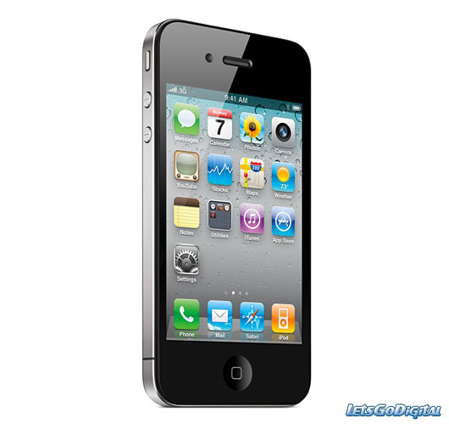
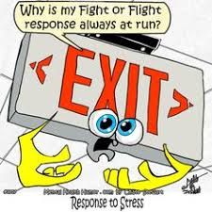
Why Does Distraction = Stress?
CONTINUOUS PARTIAL ATTENTION:
FIGHT OR FLIGHT DOESN’T STOP RUNNING
THE LINES OF WORK-LIFE BALANCE ARE BLURRED OR GONE
Average smart phone user checks their phones 150 times per day!
Emotional part of our brain on constant high alert
Hard to disconnect because our brains are naturally
wired to connect
We are constantly connecting…with little quiet time

Slide 8
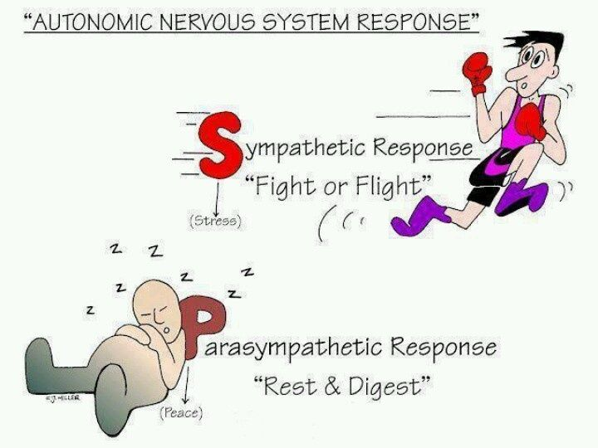
MINDFULNESS TRAINING
For relaxation
For attention regulation
For emotional coping-(concentrating on one task frees you from worry/agitation)
For improved observation
Induce the Parasympathetic Response

Slide 10
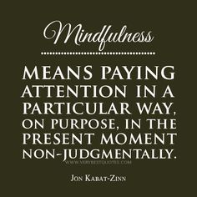
Being consciously aware of what we are doing, while we are doing it while also managing our emotions and mental state using all our senses

Slide 11
Mindfulness
Mindfulness is related to meditation
Can be integrated in every day tasks
The ONLY way to combat a distracted mind is to get quiet
May feel like you can’t do it right, but with practice it gets easier
Expect distractions, notice and pull attention back
5 minutes a day will make you better at your job and will improve your sleep

Slide 12
The ABC’s of Mindfulness Basic Relaxation Breathing
Relaxation breathing QUICKLY calms the physiology of the brain & body
Exhaling activates our parasympathetic nervous system (rest & digest)
Slowly inhale through nose 1-2-3-4
Slowly exhale through mouth 1-2-3-4-5-6-7-8 (with pursed lips)

Slide 13
AWARENESS OF BREATH MEDITATION
Mindfulness Skills Workbook, p. 85

Slide 14
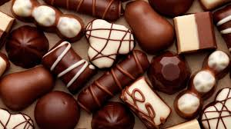
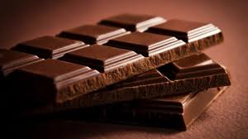
PRESENT MOMENT AWARENESS
We don’t see things as they are. We see them as we are
Anais Nin

Slide 15
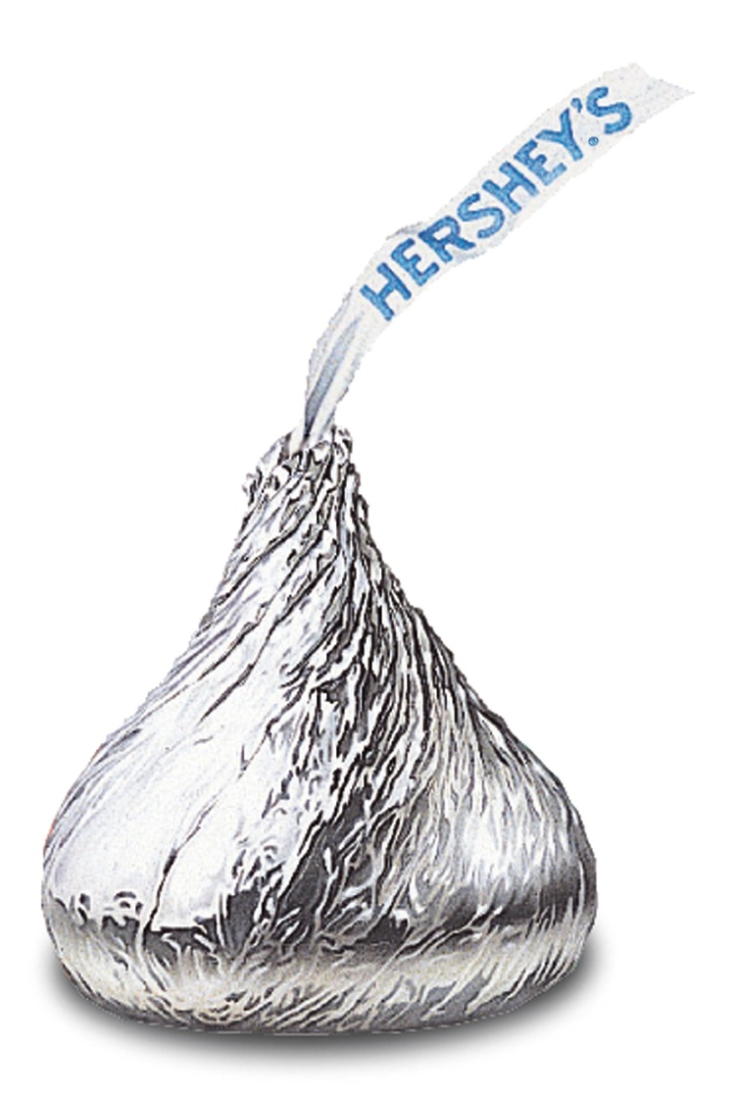
Mindful Eating Activity
Did you notice anything that you normally do not when eating a piece of chocolate?
Did you enjoy it more?
What does this simple exercise teach you about being mindful?
How can you take these insights and apply them to other aspects of your life?

Slide 16
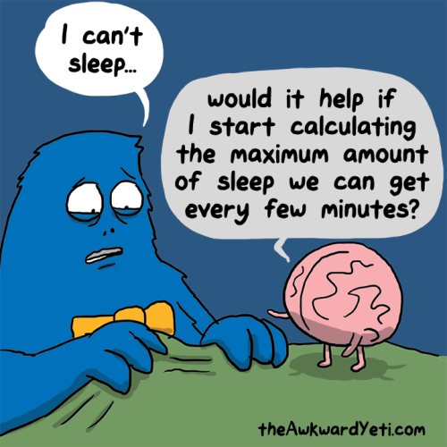
BODY SCAN Good for Sleep or Relaxation

Slide 17
Relaxed Breathing (first thing in the morning/or set intervals of your choosing)
Practice Single-tasking; focus on the task at hand. Set aside time for email/just email. Shut-off notifications. Use social network blocking software.
Set alarm or routine to practice 1 minute mindfulness breaks; can use apps, websites. “Donothingfor2minutes.com”
Practice mindful social interaction.
Apply mindfulness on your commute home—turn off phone, shut off radio for 10 minutes, drive in silence, or if you are listening to a song, listen like never before
Mindful emotional regulation (pay attention to ANT’s when uncomfortable)
Practice contemplative walking

Slide 18
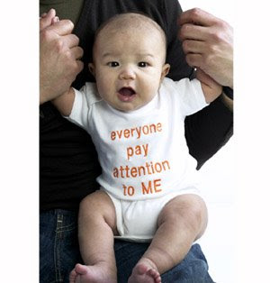
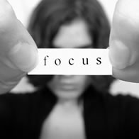
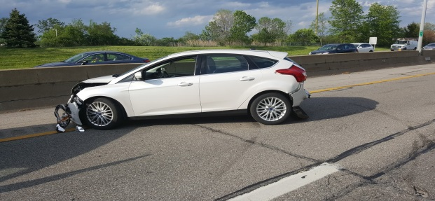
The more you can practice mindfulness the better you will be in everything you do
Focused attention to:
your work
your loved ones
your health/stress level
your emotions

Slide 19
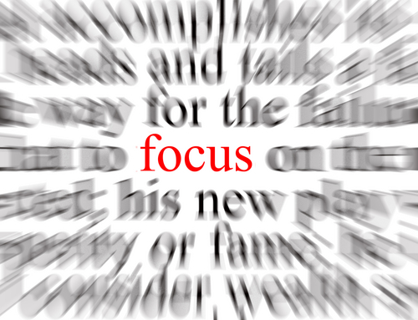
In Conclusion: Regular practice or attention to mindfulness is brain training to improve the quality of all aspects of your life.
The next 3 slides provides you with resources:
Suggested Reading
Apps or Websites to Practice Mindfulness
Apps and Software to Eliminate Digital Distraction

Slide 20
Suggested Reading
One Second Ahead: Enhance Your Performance at Work with Mindfulness. Rasmus Hougaard, Jacqueline Carter, Gillian Coutts, 2016.
Thrive: The Third Metric to Redefining Success and Creating a Life of Well-Being, Wisdom, and Wonder. Arianna Huffington, 2015.
Your Brain at Work: Strategies for Overcoming Distraction, Regaining Focus and Working Smarter All Day Long. David Rock, 2009.
Mindful Work: How Meditation is Changing Business from the Inside Out. David Gelles, 2015.
Wherever You Go, There You Are. John Kabat-Zinn, 2005.
Mindfulness Skills Workbook. Debra Burdick, 2013

Slide 21
Apps or Websites to practice Mindfulness
App for Mindful Training:
“Potential Project Mindfulness” – 8 week course
“Headspace” 10 days worth of 10 minutes of meditation
“Buddhify” designed to be used on the go/i.e. while walking, exercising etc.
Donothingfor2minutes.com

Slide 22
Apps and Software to Eliminate Digital Distraction
Anti-social.cc - social network blocking software. Allow you to avoid sites, you can set the times that you are allowed access. $15.00
Nanny – download for free on Chrome – blocks URLS from you browser and you can set limit on browser time (i.e. can set for no You Tube access from 9-5, and Facebook access for a maximum hour per day
Controlled Multi-tab Browsing – a chrome plug-in that prevents you from opening a certain number of tabs (determined by you. Free download from Chrome web store.
Siesta App (Android) or BRB (I-Phone) allows you to unplug from emails and texts without your friends thinking you are ignoring them – store up to 20 “away” messages and select recipients who receive them while your phone is off. Siesta is .99 on Google Play and BRB is free download from I-Store.

